Slide 1
14th Annual Liquor and Gaming Law Update
6 March 2018

Slide 2
Liquor Amendment (Review) Act
Freeze in prescribed precincts to 1 June 2018
Allow new grants of Producer/wholesaler licences in freeze precinct
For change boundaries, vary/revoke conditions, in-precinct removals, a patron capacity test (only) applies
Kings Cross/Sydney CBD under one set of regs (with some differences for KX- eg glass, RSA marshalls, CCTV, ID scanning)
Minors Sanction Scheme – ILGA (not Secretary) determines whether to suspend (up to 28 days). NCAT review available. No automatic stay. Apply for stay under sec 60(2) ADR Act . In stay application, NCAT balances public interest with interest of person affected.

Slide 3
Liquor Amendment (Review) Act
Three Strikes Scheme changes (from 1 Oct 2017)
Callinan review into 3 strikes scheme – heavy burden on industry, overlaps and duplicates other sanctions, harsh outcomes.
Minister said scheme had ‘unforeseen consequences’ - loans jeopardised, innocent owners’ property values reduced, sale contracts rescinded, new owners punished for actions of past owners.
The strike is incurred by the licensee/approved manager, NOT the licence (except clubs). Strike is personal, in this sense.
“Prescribed offences” (which must be by licensee/approved manager : cf. minors sanction scheme) narrowed. Breach of conditions (in prescribed precincts or for violent venues) still may cause strike, but only for breach of trading hours conditions.
All strikes now discretionary (1st was mandatory).All strikes imposed by ILGA (previously 2nd imposed by Secretary)

Slide 4
Liquor Amendment (Review) Act
ILGA may impose a strike because of “seriousness of harm that may have resulted from, or been associated with” the offence: 144E(1)(c).
On a 2nd or 3rd strike, business/premises owners (who have their interest recorded with ILGA) are given notice: sec 144M(1)(a).
Where a strike is incurred, ILGA may take ‘remedial action’ - impose conditions on the licence. Potential conditions become more severe with additional strikes.
On a 3rd strike, ILGA may still suspend or CANCEL the licence, as well as suspend/disqualify licensee and associates: sec 144G(3)(b).

Slide 5
Liquor Amendment (Review) Act
New “anti-churning” provision: sec 144H. If licensees are being churned, primarily to avoid remedial action for strikes, and bad conduct is ongoing, ILGA may impose conditions to stop churning or otherwise to manage/limit risks of re-offence.
Strike takes effect when ILGA imposes the strike (not when the offence occurs). Remains in force for 3 years, unless revoked earlier: 144K(2), but remedial action (conditions) continue: sec 144K(3).
New ‘review’ mechanism for strikes to be revoked by ILGA on application by licensee/manager, made more than 6 months after strike imposed: sec.144O. Must show compliance with remedial measures, measures/training to deal with risks that caused strike and no more prescribed offences have occurred.

Slide 6
Liquor Amendment (Review) Act
If ILGA revokes strike, any remedial measures cease to have effect: sec 144O(5). [So should always invoke this procedure, while strike is on foot, to remove condition?].
NCAT administrative review available for decisions to impose a strike and/or take remedial action: sec 144N. 21 days to make application for administrative review: 144N(2). Decision is stayed pending review, unless NCAT determines otherwise: sec 144N(4).
Clubs. Strikes still relate to the licence, (not personal to the licensee or approved manager) but no cancellation/suspension available. Worst available sanctions are appointing an administrator, or permanently disqualifying individuals from holding office (including on Club’s Board).

Slide 7
Liquor Amendment (Review) Act
Transitional Provisions – Any strike incurred before 1 Oct 2017 is revoked: Act Schedule 1, cl. 57(1).
Conditions imposed under previous strikes continue: cl. 57(2).
New strikes can only be incurred for offences committed after 1 October 2017: cl. 57(3).

Slide 8
Other Changes
ePINs. Act amended to allow for issue of e-PINs. E-PIN will issue when recipient elects to receive electronically. Details in Fines Act.
Interim restaurant authorisations commenced. Provision made for them to be revoked.
Deemed provisional approval of change boundaries for licensed restaurants if area is used for sale of liquor ancillary to outdoor dining and council approval has been obtained: cl. 80B Liquor Reg.
Compliance risk loadings to annual fees. Removed step-up of loadings where a strike is in force.
New cl. 9C gives ILGA some discretion to excuse non-compliance with advertising requirements. May alleviate harshness of decisions such as Coote, Blackhead SLSC and Wild Rover.

Slide 9
Other Changes
Clause 9C discretion may be exercised if ILGA is satisfied that:
(a) applicant has made all reasonable efforts to comply; or
(b) the failure is of a minor or technical nature.
Evidence of age documents now include:
- digital drivers licences issued by RMS and which have a DOB
KeyPass identity card, issued by Australia Post.
Provision for PINs under the GALA Act.

Slide 10
Other Changes
Justice Legislation Amendment Act, passed September 2017, affects NCAT reviews of ILGA decisions, under the GALA Act.
Formerly read:
“[Administrative review] is to be way of rehearing rather than a new hearing” : sec 13A(2) GALA Act.
Now sec 63 ADR Act applies, which admits “any relevant factual material”.
In Auld (No 2), NCAT had ruled that 13A(2) limited the inquiry to the same materials before LGA, subject to NCAT discretion to admit new materials (with discretion to be sparingly exercised).

Slide 11
NCAT
Current volume of admin review applications
Only one determined so far.
WHO can start admin review proceedings before NCAT?
  Applicant aggrieved by ILGA decision;
  Person required to be notified and who made submission before ILGA: sec 13A(5) GALA.

Slide 12
NCAT
WHAT matters can be subject to admin review?
Grant/removal of club/hotel/PLL, on-premises (public entertainment)
ETAs and condition changes for post-midnight trading
Gaming machine threshold increases requiring a Class 2 LIA
WHEN must an admin review be made? Within 28 days after publication on ILGA’s website: sec 13A(3). NCAT has power to extend time: sec 41 CAT Act.
WHERE is NCAT? John Maddison Tower, 86 Goulburn St
HOW do I commence an application?

Slide 15
NCAT
How much? Fee is $100 on lodgement.
What next? NCAT Registry notifies ILGA (but let them know anyway).
Sec 58 ADR Act requires ILGA to lodge all its materials with NCAT (subject to legal privilege and GIPA matters) and for NCAT registry to make available to applicant. Usually applicant is served with a copy.
NCAT notifies of directions hearing, where matter will be set down for hearing, with directions for filing and service of evidence in advance.
Joinder – Auld (No 1) – NCAT refused application to join Secretary and for ILGA to bow out as a submitting party.

Slide 16
NCAT
Procedure – Similar to Class 1 Land and Environment Court. Single member.
Professional costs. Presumption is that NCAT is a ‘no costs’ jurisdiction (exercising administrative not judicial power), but has power to award costs in ‘special circumstances’: sec 60 CAT Act.
Further appeals: Aggrieved party has a right of appeal, on a question of law, to NCAT’s Appeals Panel: sec 80(2) CAT Act. The Panel may grant leave to consider not just questions of law, but also other grounds (sec 80(3)), including potentially a new hearing and fresh evidence. Such appeals to be filed within 28 days. Appeal Panel may stay decisions pending appeal: sec 83.

Slide 17
NCAT
Auld v ILGA (Auld No. 3)
Removal of hotel licence in Young, 400 metres to an ALDI supermarket to be used only for packaged liquor sales.
Petition signed by over 1900 people in favour of removal. No objections. Police expressed some concern about proximity to public housing – addressed by applicant in CIS and then no Police objection.
Application refused by ILGA on DA and social impact grounds.
As to DA, sec 45(3)(c) Liquor Act requires applicant to have DA to “use the premises for the purpose of the business or activity to which the proposed licence relates”. ILGA said this required applicant to have DA for a hotel.

Slide 18
NCAT
As to social impact grounds, ILGA refused because:
Proximity of ALDI to ‘nearby’ public housing
Higher than State average rates of alcohol-related assault
Relative disadvantage in Young (SEIFA deciles of 3)
“High’ licence densities
Possible downward pressure on liquor prices from new competitor
Likely to contribute to existing over-exposure to alcohol-related assault, esp DV assault.

Slide 19
NCAT
Before NCAT applicant initially relied on evidence lodged with ILGA (“rehearing”).
ILGA served a statement from Dr Christopher Morrison, Uni of Pennsylvania, epidemiologist. Dr Morrison’s propositions:
  Off-premises outlets concentrate in poorer areas
  They generally sell at lower prices
  Alcohol consumption and harms are greater in areas where there is a greater concentration of outlets/lower prices.
  Dr Morrison argued that grant of this application was likely to lead to lower prices, more liquor consumed and greater harm caused, to an already ‘vulnerable’ population.

Slide 20
NCAT
Dr Morrison was extensively cross-examined via audio-visual link from his University offices in the eastern US.
Applicant called an experienced town planner, George Smith whose report challenged many of Morrison’s propositions, as they applied to NSW and Young.
Hearing ran for 2 days.
Decision reserved for nearly 6 months. Senior Member Ransome set aside ILGA’s refusal and granted the removal.
SM Ransome determined that ALDI only needed a DA for the particular business or activity that it intended to operate (liquor retail) and not for a ‘hotel’. ALDI had the required consent.
As to social impact:

Slide 21
NCAT
Secretary’s internal (EVAT) assessment to ILGA had not identified any high risks
High alcohol-related heath stats were mitigated by the absence of any objection by health authorities
DV assault rates not greatly above average (1.2 times State) and similar to Regional rates.
Accepting some general truth to Dr Morrison’s propositions, difficult to apply to Young specifically.
While densities appeared high, not the case when dormant licences and restricted licences were discounted. “Unreality” including those when assessing densities.

Slide 22
NCAT
Public support given weight (but rejected applicant’s submission that should be given decisive weight)
Evidence of high densities giving rise to probematic rates of DV assault- but this only occurred at much higher densities than are present at Young.
Appeal filed last week.

Slide 23
Legislative Reviews
CIS review
LIA review (submissions closed June 2017). To consider (inter alia):
Geographical area to measure social impacts
Banding system
Risk criteria to apply (beyond EGM density/EGM expenditure)
Consultation process
Positive contributions
Whether existing LIA exemptions remain (same LGA/ under 20 in Band 1)

Slide 24
ETAs
A number of ETAs granted for post-midnight trading.
Examples of ETAs granted after a previous refusal: Bath Arms Burwood, Tiger Bar Hurstville, Castle Hill.
Ability to ‘go dry’ after midnight: sec 15A Liquor Act.
Note that ILGA can require details of social impact of gambling activities in the post-midnight period: cl 10A Liquor Reg and sec 48(7) Liquor Act. Also balanced development of related industries (gaming): sec 3(1)(c) Liquor Act.

Slide 25
Cases
Mader v R [2017] NSWDC 100, Scotting DCJ
cl. 53ZC Liquor Reg - a licensee must not “promote, publicise or cause to be promoted or publicised” supply of free or discounted shots.
Normal price of shots at Midnight Shift was $9.
Hotel’ Facebook site advertised $5 shots for an upcoming Ladies’ night “Climax”. Facebook site kept by hotel’s Promotions Manager.
Police see the promotion on Facebook and tell Manager, who didn’t know of it. Manager took it down. Promotion did not proceed.
Police prosecuted. Magistrate convicted. Mr Mader appealed.
Held, not guilty.

Slide 26
Cases
R v Mader:
For a person to ‘cause’ something to be done, he/she must have given some order or command that it be done. No evidence of that here.
No evidence that there was any express or implied authority on the Promotions Manager to advertise such promotions or that it was otherwise within the scope of her authority.
Mr Mader not vicariously liable under sec 149 Liquor Act – that section only applies to ‘sale’ or ‘supply’ of alcohol in breach of the Act.

Slide 27
Cases
Lynch v ILGA
Lynch sold freehold of the Town and Country Hotel with vacant possession, but retaining ‘ownership’ of the hotel licence and GMEs.
Before settlement, Lynch makes application to remove licence to new premises.
After settlement, buyer applies to transfer the licence OIP: sec 61.
ILGA held it could no longer determine Lynch’s removal application, as Lynch was no longer licensee.
SC held that ILGA had continued jurisdiction. Application was validly made when Lynch was licensee and there is no loss of power thereafter.

Slide 28
Cases
George Thomas Hotels (Campsie) PL v Buckley
Buckley applied for removal of hotel licence (from Hurlstone Park to Campsie) and also sought a GMT increase of 27 for the “new hotel” premises at Campsie.
Buckley told ILGA he did not want to remove the licence if GMT increase also not granted.
ILGA refused the GMT increase in 2015 and treated the removal as “withdrawn”.
Buckley successfully took judicial review proceedings in the Supreme Court, quashing the ILGA decision.
Matter remitted back to ILGA. Objectors argued that the removal application could not be granted, as it had been “withdrawn”. Objectors sought injunction preventing ILGA from granting the removal.

Slide 29
Cases
(Objectors originally sought injunction against ILGA only. Mr Buckley had to bring a motion seeking to be joined).
Objectors’ claim for relief refused. Held that, in upholding Buckley’s claim for judicial review, the previous Supreme Court judge had quashed all aspects of ILGA’s decision, including the decision to treat the licence removal as “withdrawn”.

Slide 30
Notable ILGA Decisions
Campsie – 17 January 2018
Significant in determining whether a hotel is in the “immediate vicinity” of a public school: cl 36(2) GMR.
Edge of school yard 50 metres from rear loading dock, down a little-used laneway. Nearest public entrances 70 metres apart. No line of sight. Hotel to open 10 am schooldays. About 175 schoolchildren would pass the hotel on way home from school, mostly accompanied by adults.
In 2015, ILGA had held hotel was in ‘immediate vicinity’ of school, based on distance. That decision was quashed by SC in 2016.
Matter remitted to ILGA, which required new CIS.

Slide 31
Notable ILGA Decisions
This time, different ILGA Board determined that proposed hotel NOT in the immediate vicinity of the school.
While noting potential for school children to be impacted by hotel patrons , hotel was so disconnected, visually and physically, from the school that it could not be said that the hotel was in the school’s “immediate vicinity”.
ILGA also rejected an argument that the whole of the Campsie town centre is a ‘retail shopping centre”. (If the proposed new hotel were in a “retail shopping centre” it could not have gaming machines: sec 37B GMA).

Slide 32
Notable ILGA Decisions
Removal application and GMT of 27 granted, but ETA refused by ILGA on social impact grounds. Why refuse ETA?
Crime rates in Campsie low, but evidence of concentration in after-midnight period.
Likely to be patron migration after midnight, causing amenity impacts.
As to gaming-related impacts, evidence of very high EGM spends in Campsie ($345K pa per hotel EGM vs $95K for State) and that Campsie a relatively disadvantaged community.
Literature suggests problem gamblers play longer, more intensely and later.
20-60% of EGM spend from problem gamblers

Slide 33
Notable ILGA Decisions
Productivity Commission recommended a pre-2am shutdown to safeguard against problem gambling.
Refusal of post-midnight trade would prevent against problem gamblers gambling longer.
Red Lantern, Eastwood, 28/7/2017, refused.
Application for new hotel licence in carpark of Eatwood Hotel.
To be a “Korean style” hotel.
Opposed by Police, NSW Health LHD and a local club.
Substantial purpose appeared to be to get another 30 EGMs

Slide 34
Notable ILGA Decisions
ILGA found proposal would have little public benefit and would create a cluster of venues, which would create patron migration/amenity issues.
Applicant argued that social impact of gambling not relevant to licence application. Was no GMT lodged with hotel application. Applicant argued that social impact of gambling to be considered later, when GMT lodged (was a Band 1 area). Argued that gambling social impact only relevant post-midnight: sec 48(7). (Applicant only sought standard hours, to midnight).
ILGA held that social impact of gaming was relevant – sec 3(1)(c) requires ILGA to consider the balanced development of related industries (incl gaming)

Slide 35
Notable ILGA Decisions
There was evidence of problem gambling. Granting the application would not further the balanced development of the gambling industry.
Application refused.

Slide 36
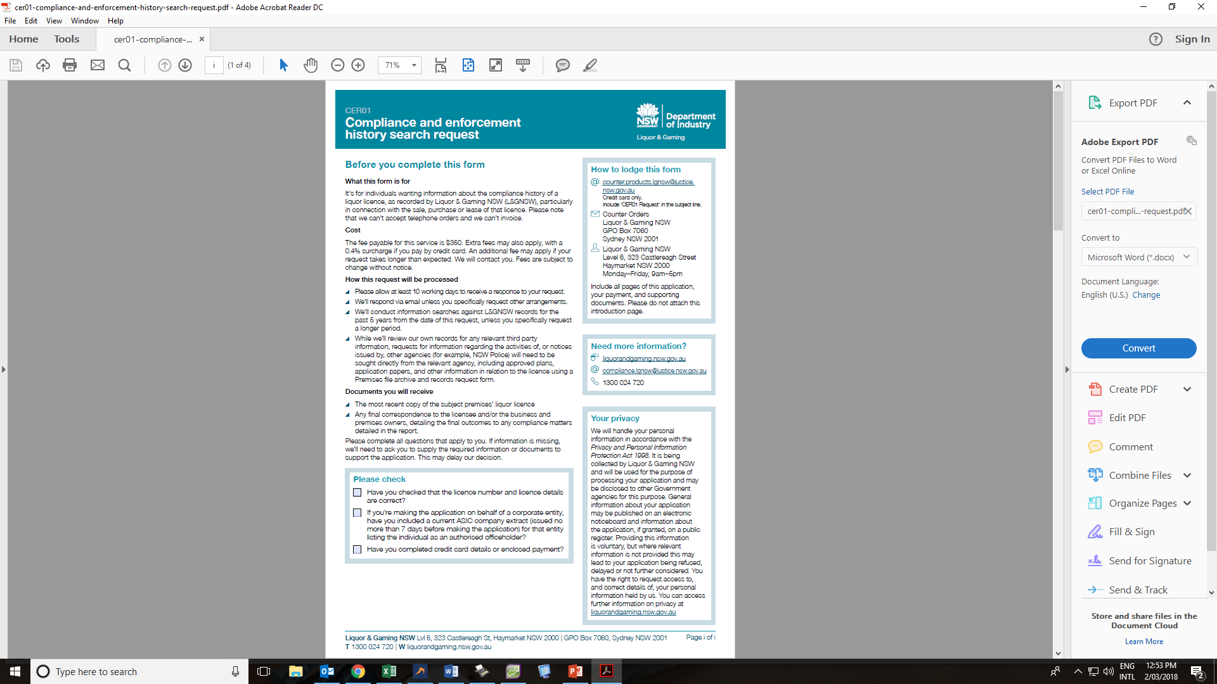
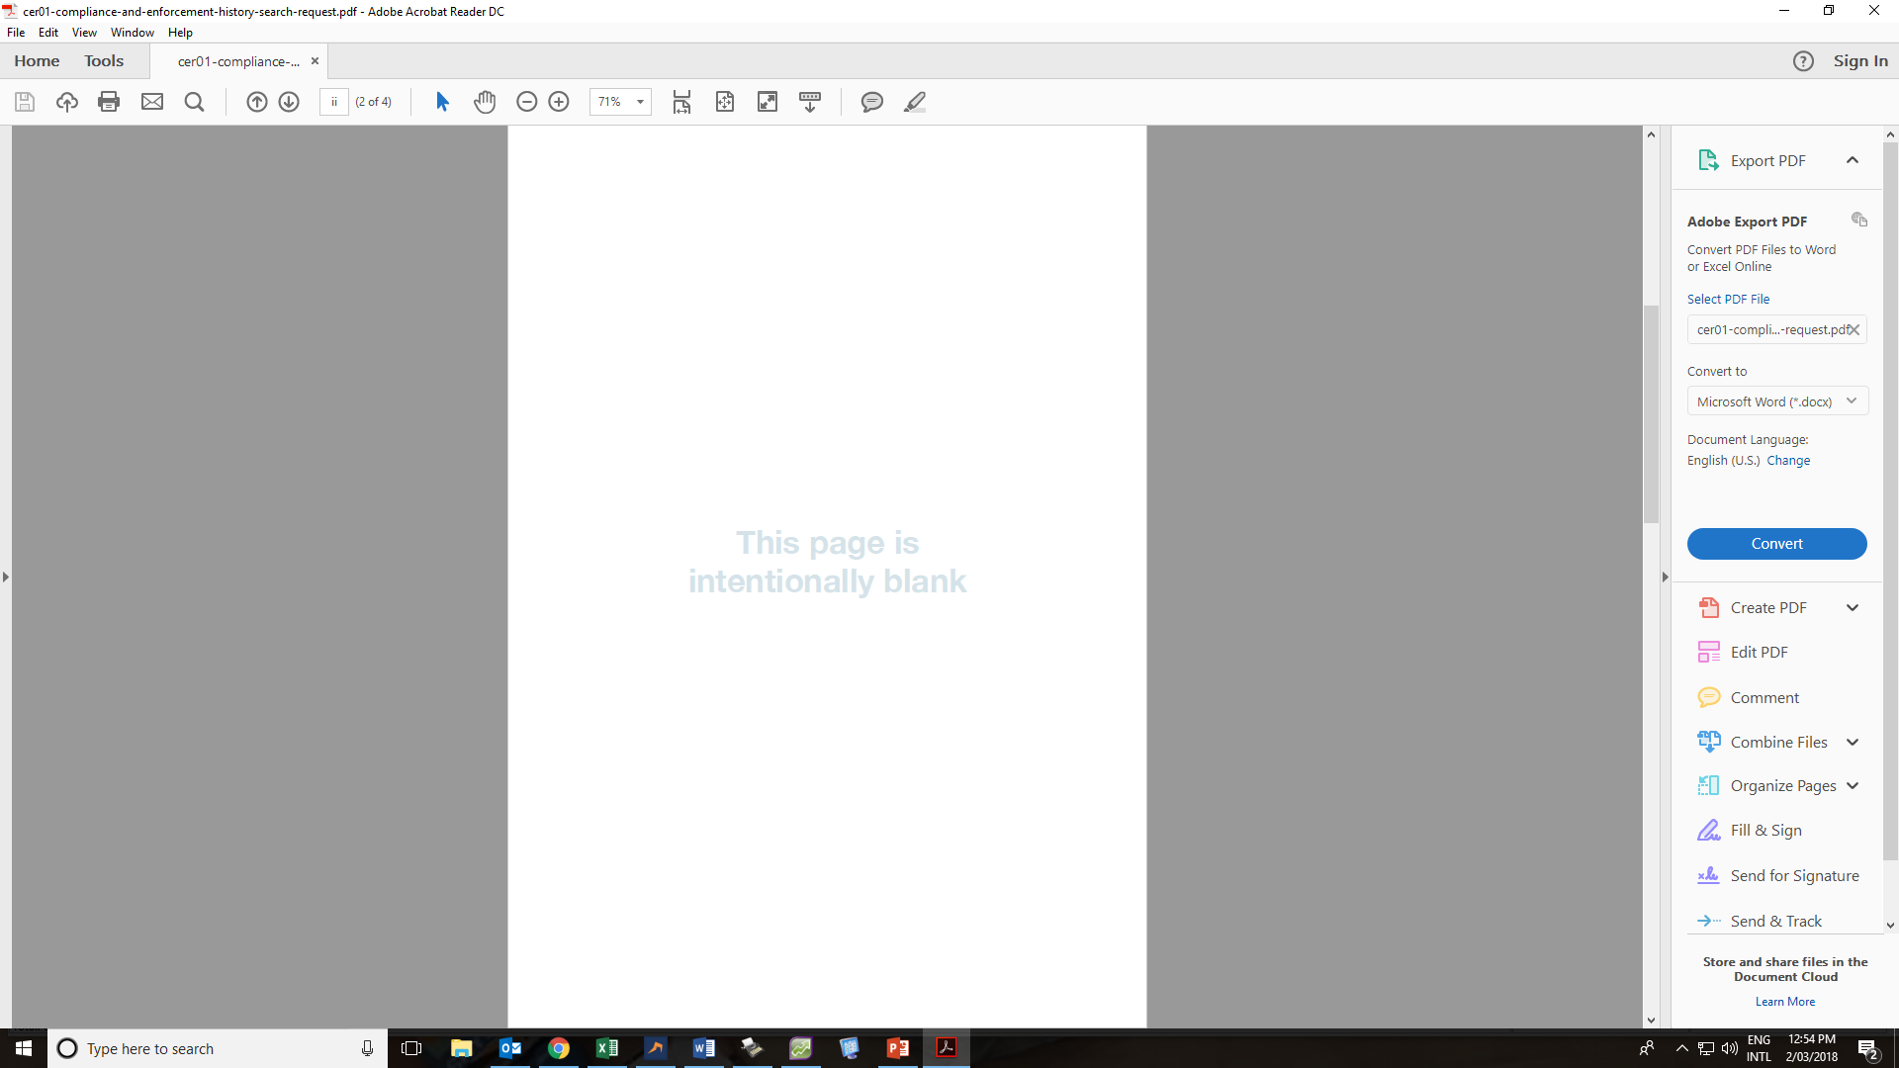
Compliance and Enforcement History Search Request

Slide 37
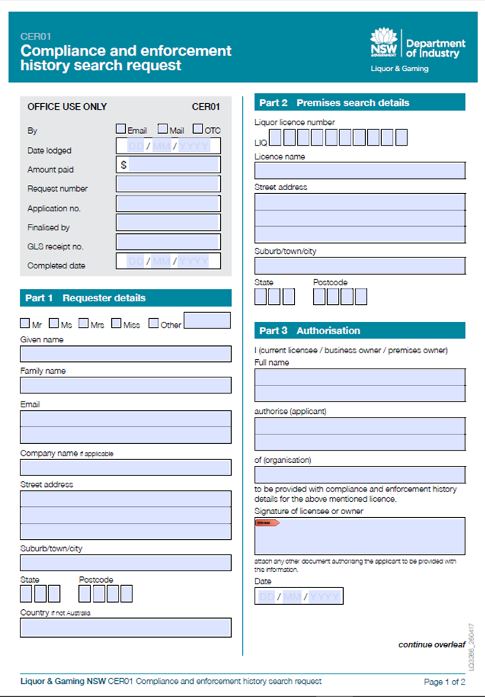
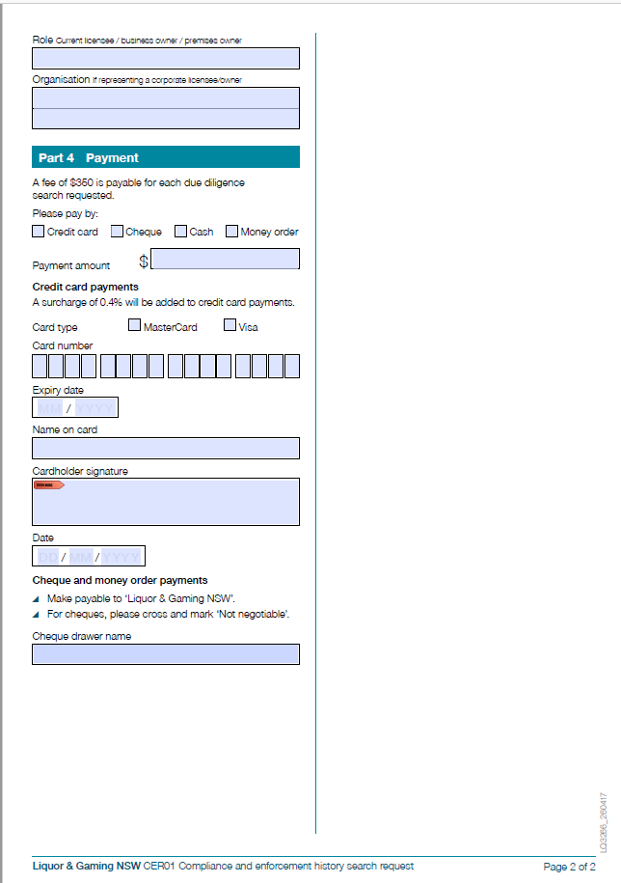

Slide 38
Premises File Archive and Records Request

Slide 39
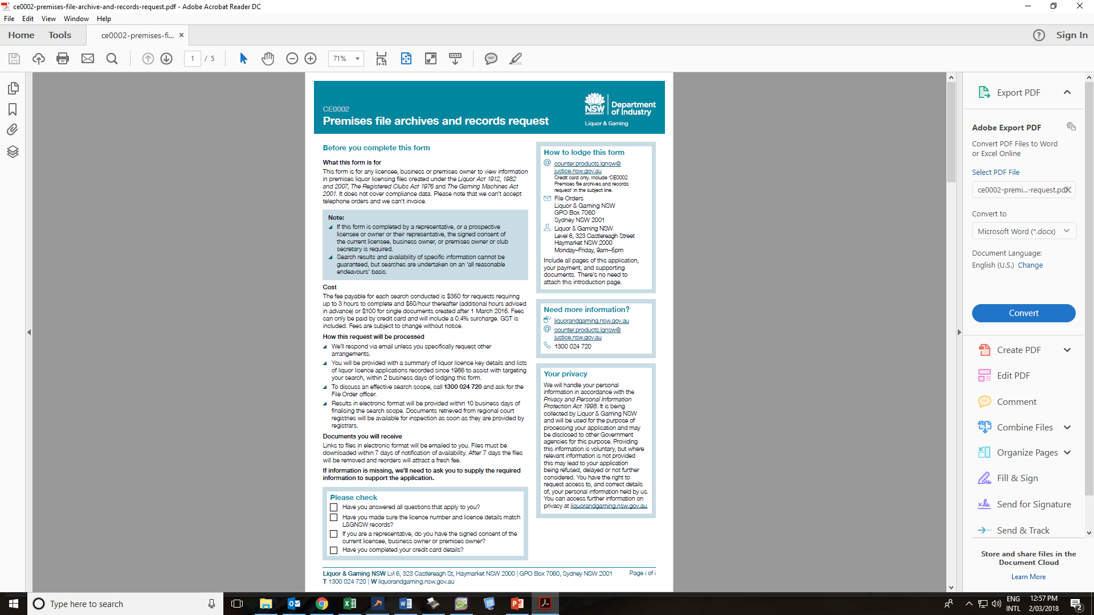
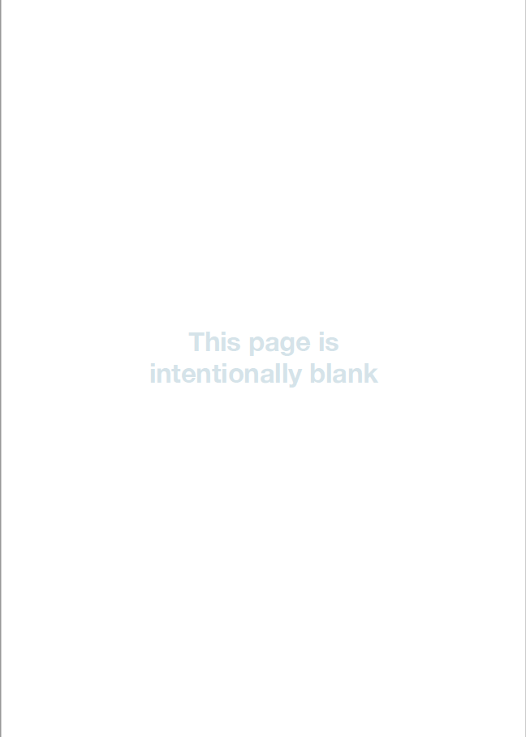

Slide 40
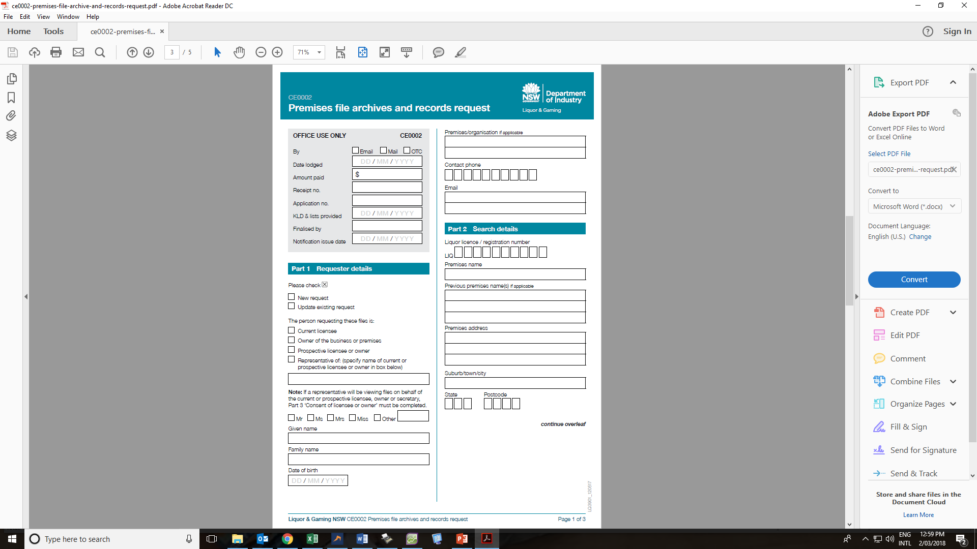
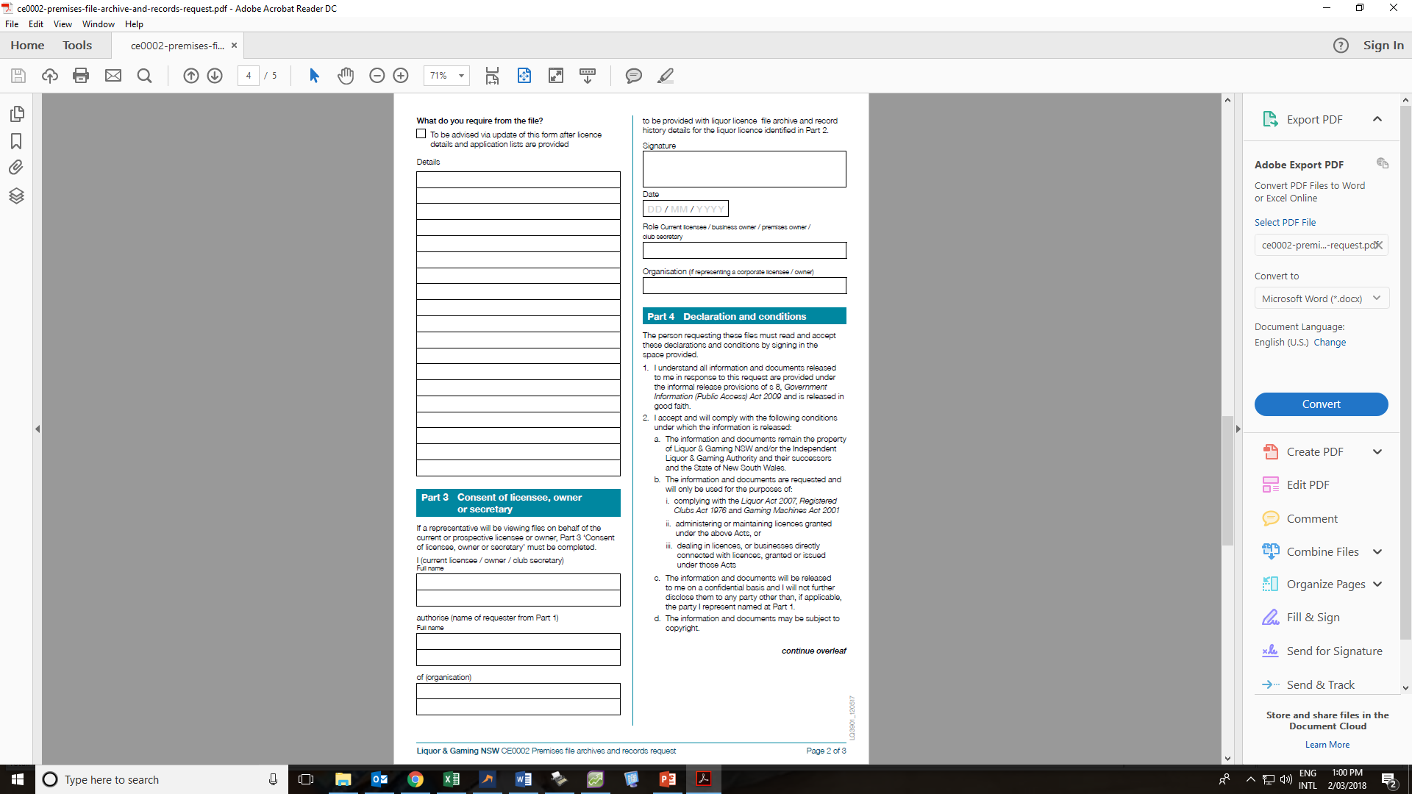

Slide 41
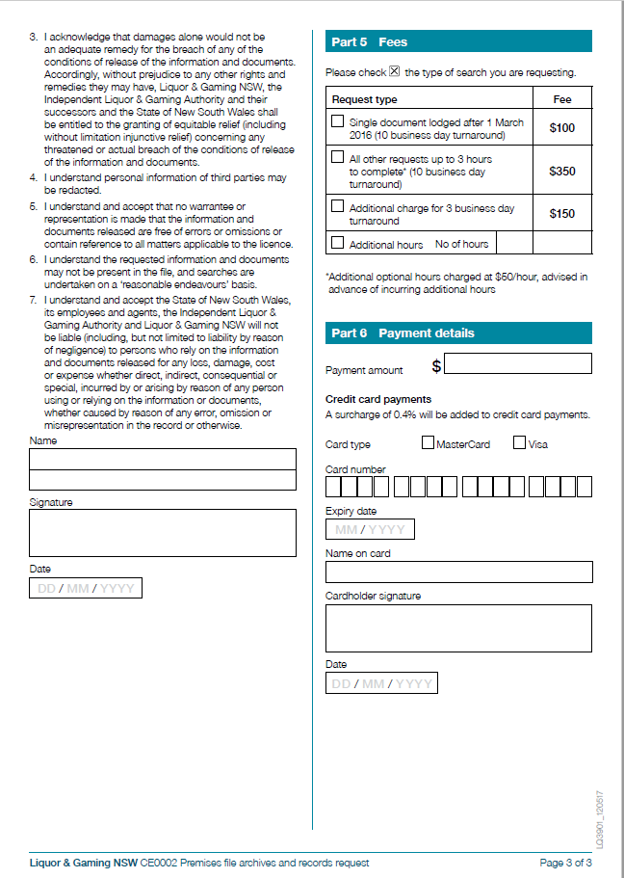

Slide 42
Premises Licence Data Request

Slide 43
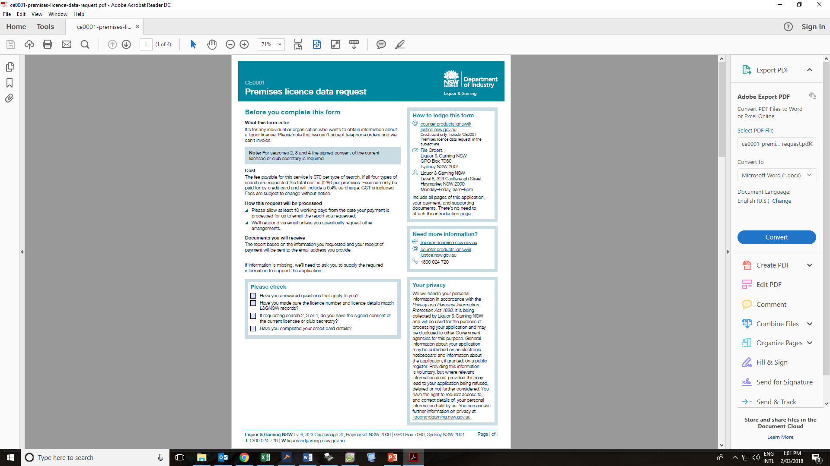
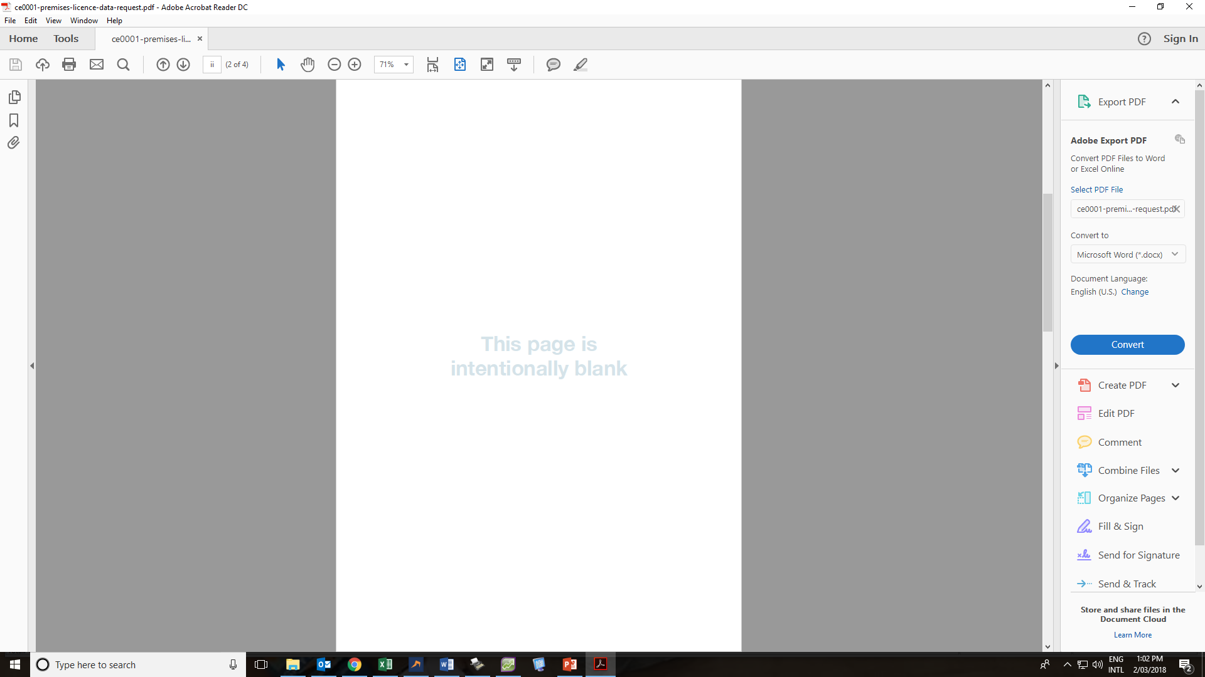

Slide 44
